Slide 1
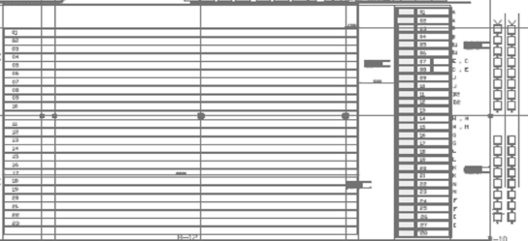
Plane
Sorting
Dolly Supply
A
13
B
14
C
15
J
16
U
6
E
B
7
D
A
8
F
9
UNP
10
G
11
H
12
P
D
K
C

